Slide 1
GERAS
Abdelmounaim DEBIECHE

Slide 2
Agenda
Level of abstraction
What is the problem ?
Solution: DSL
Notes:
I will provide a broad overview of ThingML, present some challenges and interesting features that are missing in ThingML and suggest some potential contributions of our own.

Slide 3
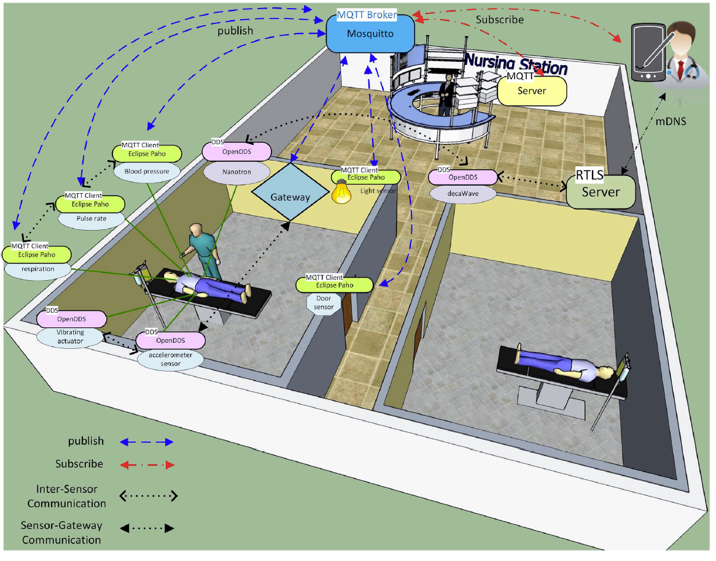
Level of abstraction

Slide 4
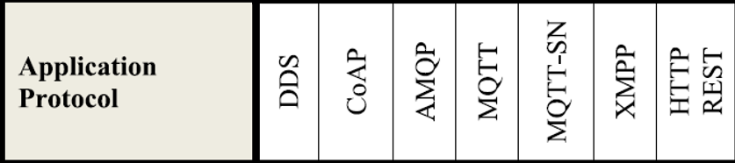
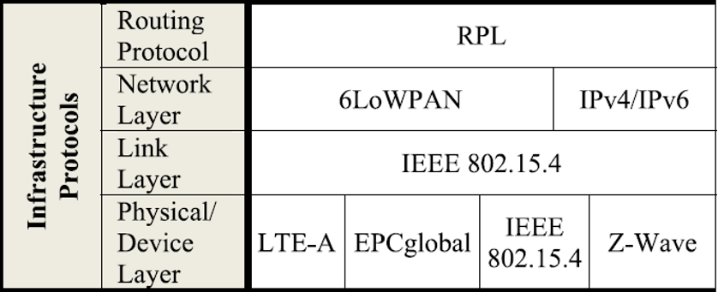

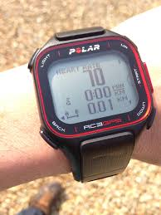
Level of abstraction
Business Layer
GERAS
Application Layer
Application Layer
Service Management
Infrastructure Layer
Object Absetraction
Objects

Slide 5
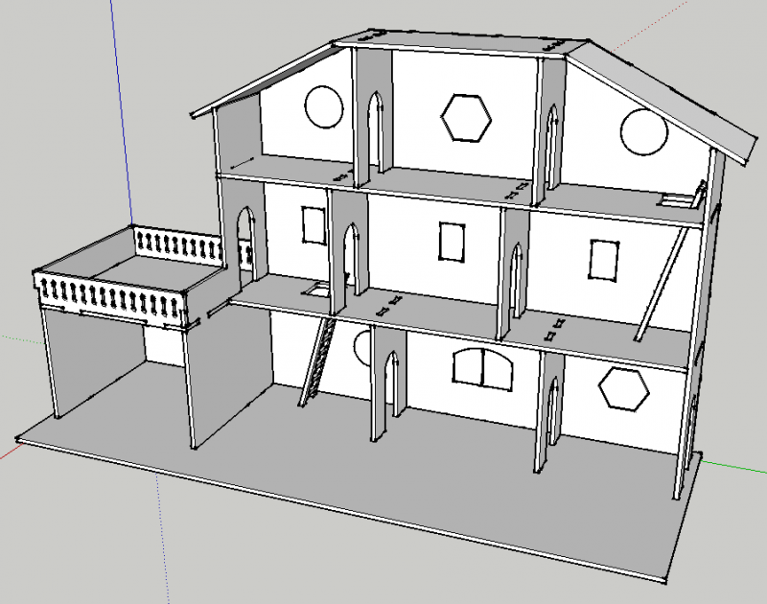
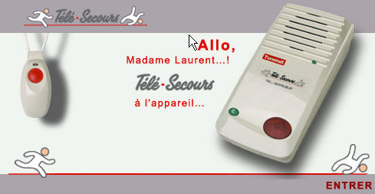
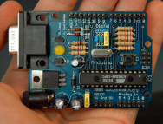

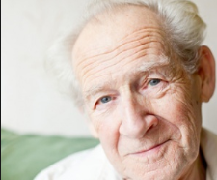




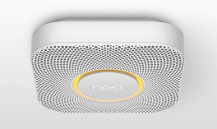

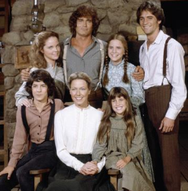

The problem
What happen if I fall and become unconscious?
What happens if I do not hear a sound of phone ringing?
What happens if I forget to close the door?

Slide 6
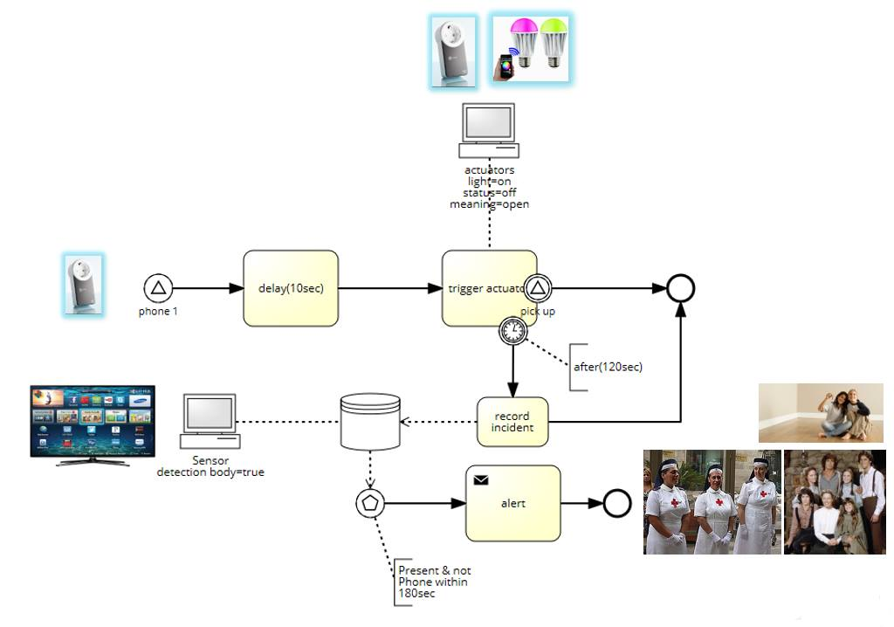
The problem: activity diagrams

Slide 7
Solution :DSL
Type Declaration
Network Configuration
Business Rules

Slide 8
Type Declaration

Slide 9
Network Configuration

Slide 10
Business Rules

Slide 11
Conclusion
Level of abstraction
Scenario

Slide 12
Proposal
DSL
SCENARIO
Prototype

Slide 13
Question
Is it interesting to develop a DSL?

